Slide 1
Ext JS - Components
1
Prajwal Gajanan Ponarkar
2
Nikhil Aryan Kohli
3
Diya Jain
4
Elvina Francy H
5
Pooja D

Slide 2

Ext JS: Building Modern Web Applications
Ext JS is a comprehensive JavaScript framework for building interactive web applications. Developed by Sencha, it's well-suited for creating data-intensive and cross-platform applications with rich user interfaces.

Slide 3
Key Features: Rich UI Components
Grids
Forms
Charts
Trees
Display and manipulate tabular data efficiently with built-in sorting, filtering, and editing capabilities.
Collect and validate data from users with a variety of input fields, such as text boxes, dropdowns, and date pickers.
Visualize data effectively with various chart types, including line charts, bar charts, pie charts, and scatter plots.
Organize and display hierarchical data in a visually appealing and interactive tree structure.

Slide 4
Ext JS: Architecture and Data Management
MVC/MVVM Architecture
Data Package
Simplify development by separating concerns into distinct layers: Model, View, and Controller (or ViewModel).
Manage data models, stores, and proxies with ease, enabling efficient data binding and synchronization with backend services.

Slide 5
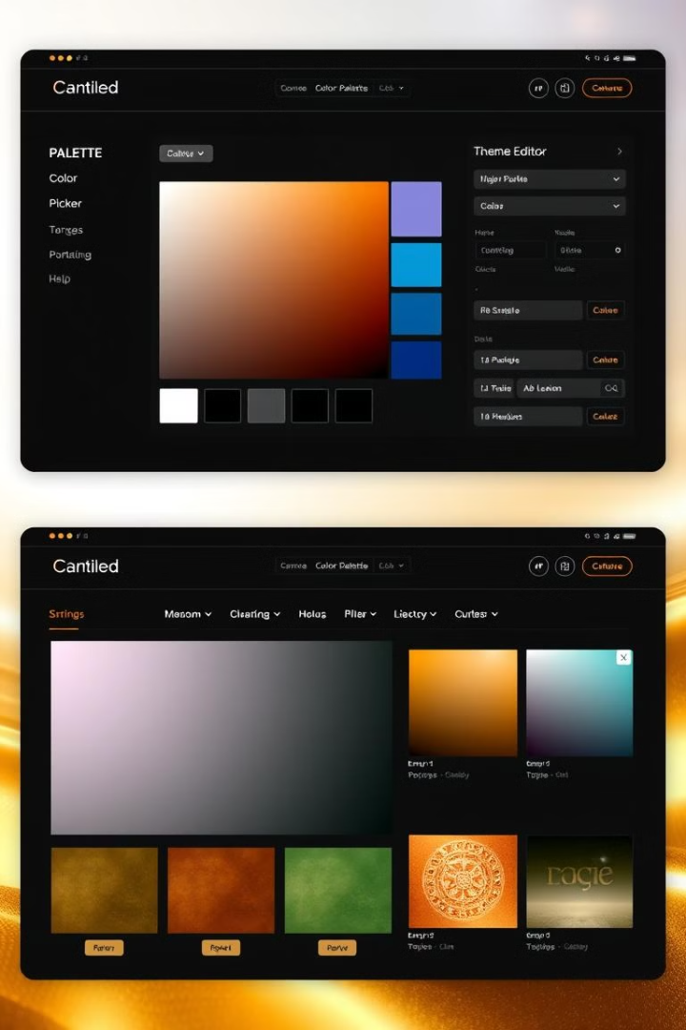
Ext JS: Customization and Responsiveness
1
Customize the look and feel of your applications with the theming system, using Sass for styling and design flexibility.
2
Ensure your applications work flawlessly across various devices and screen sizes with built-in responsive design capabilities.
3
Integrate Ext JS with other popular JavaScript libraries and frameworks, such as React and Angular, to extend functionality.

Slide 6
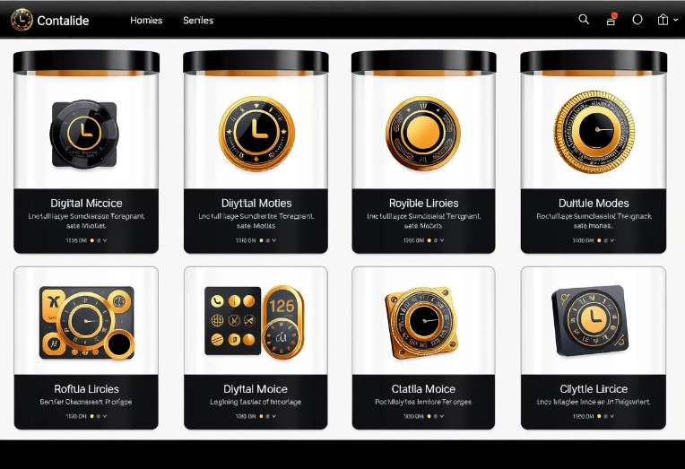

Building with Ext JS: Containers and Layouts
Containers
Layouts
Hold and organize other components within your application, providing structure and organization.
Define the arrangement and positioning of components within containers, allowing for flexible and visually appealing layouts.

Slide 7



Ext JS: Building User Interfaces
Use Ext JS components to build visually appealing and interactive user interfaces, providing a seamless experience for your users.
Leverage the extensive documentation, tutorials, and community resources to learn and build your applications efficiently.

Slide 8

Ext JS: Common Use Cases
1
Build enterprise-level applications with complex data handling and rich user interfaces, streamlining workflows and enhancing productivity.
2
Create single-page applications (SPAs) with a seamless user experience, delivering dynamic and engaging interactions for your users.
3
Build data visualization applications with advanced charting capabilities, enabling users to gain valuable insights from their data.

Slide 9

Ext JS: Final Thoughts
Ext JS is a powerful tool for developers who need to build complex, data-driven web applications. Its robust feature set, extensive documentation, and active community make it a valuable choice for a wide range of projects.

Slide 10

Thank You!
We hope you enjoyed this presentation on Ext JS.

